Slide 1
Development Best Practices
Concepts & Microsoft’s Approach

Slide 2
Agenda
Collaborate & Communicate
Manage Team Workflow
Drive Team Predictability
Ensure Quality Early & Often
Integrate Frequently
Make Real-Time Decisions
& Microsoft’s Approach

Slide 3
Team-Related Mistakes
Performing tasks without perceived value
Shipping low quality
Bad deadlines, estimates, and requirements
Not enough feedback and going dark
Death marches
Notes:
Use Principles to Guide Teams
Simplicity
Crystal-clear shared vision
Consistency
Traceability
Categorization
Refactoring
Feedback

Slide 4
Signs of a Great Team
Intensely happy team members
Momentum and velocity
Joint ownership and pride
Amazing software—on time and on budget
And this is why…

Slide 5
Collaborate & Communicate
Remove barriers that create inter-role disconnects
Stakeholder>Developer
Developer->Tester
Interpret != Implement
Centralized, extensible artifact repository

Slide 6
Manage Team Workflow
Efficient Management of Work Elements
Tasks, Defects, Requirements, etc.
Enable Traceability
What came from what?
Audit support

Slide 7
Drive Predictability
Clearly Define a Process
Proven
Realistic
Repeatable
Enforceable
“Baked” into systems
Leverage existing, familiar tools

Slide 8
Ensure Quality, Early & Often
Quality-Centric Tools
Integrated throughout lifecycle
Reduces overall project cost
Lifecycle
Planning
Design
Development
Testing
• Work Tracking
• Requirements
• Scenarios
• Tasks
• System Modeling
• Deployment Modeling
• Unit Testing
• Database Testing
• Static Code Analysis
• Performance Profiling
• Continuous Integration
• Scheduled Builds
• Load Testing
• Web Testing

Slide 9
Integrate Work Frequently
Continuous Integration
Robust version control
Integrated with defect & task tracking systems
Automated testing
Unit Testing
Functional Testing
Load Testing

Slide 10
Integrate Work Frequently Build Automation
Consider build customers
Development team
Testing team
External adopters
Customers
Build scenarios
Manual
Scheduled
Continuous
Force a sync point across these roles
Act as checkpoint between dev and test
Compile, run tests, gather metrics
Heartbeat and heath check
Critical to reporting and feedback
Couple with gated check-in

Slide 11
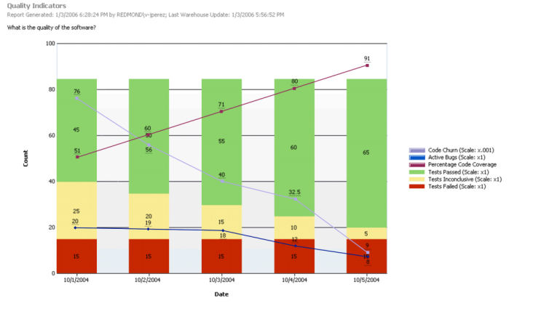
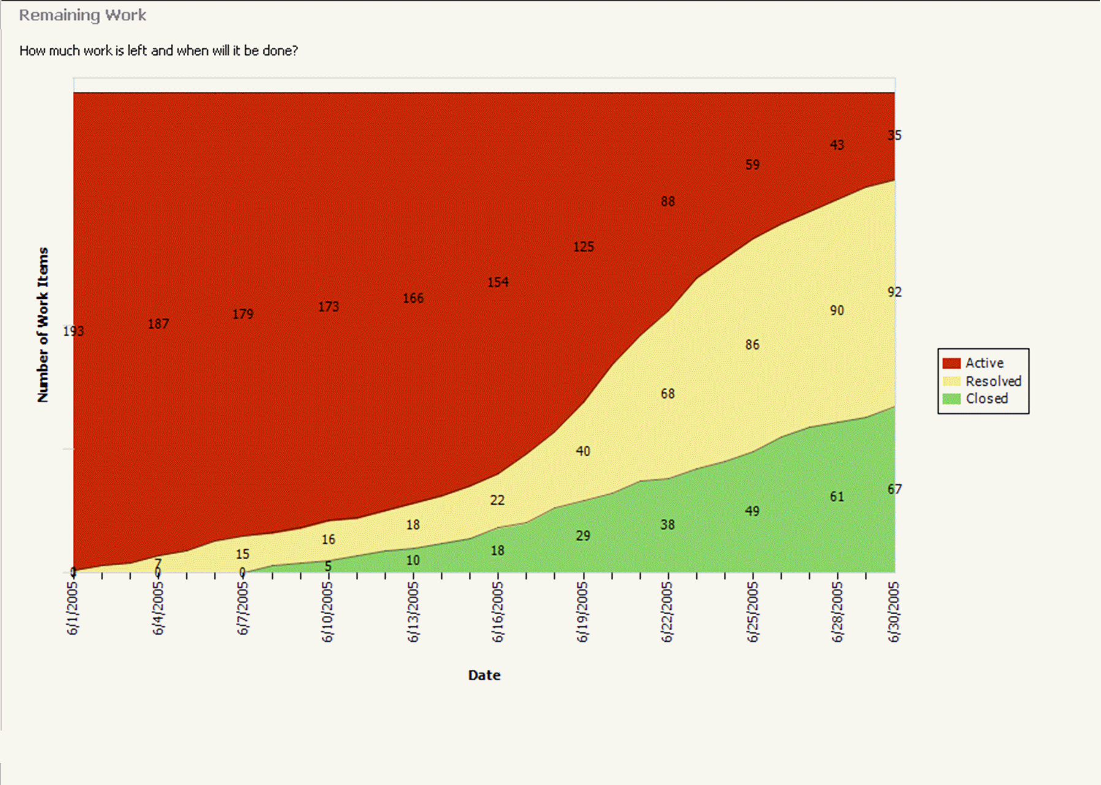
Make Real-time Decisions
Open the “Black box” of the lifecycle
Comprehensive business intelligence reporting system
Real-time data
Enabling critical decision making
Readily Accessible

Slide 12
Layering Best Practices
Process and tools support individuals, teams and organizations frictionlessly and transparently
Overcome Complexity
Quality Mindset
Culture of Innovation
Collaboration
Transparency
Integration
Clarity
Alignment
Efficiency
Highly integrated Productive Extensible Low administration
Agile Customizable Lightweight Patterns and practices Flexible
Notes:
The idea is you can take all of your learned best practices and begin to layer them into areas that need the most help. The notion of “best practices” apply at many levels when talking about the Application Lifecycle – from the individual to the organization.

Slide 13
Development Best Practices
Microsoft’s Approach
Notes:
Now let’s see what Microsoft can do to help with these best practice concepts..
Because this is how we roll!

Slide 14
Microsoft’s Approach
Collaborate & Communicate
Team Foundation Server
Manage Team Workflow
Work Item Tracking
Drive Predictability
Process Guidance & Automation
Ensure Quality, Early & Often
Comprehensive Testing
Integrate Work Frequently
Version Control
Team Build
Make Real-Time Decisions
Integrated Reporting
Extensible
Notes:
Conveniently enough, Microsoft provides solutions to help with all the key areas of success. It’s all wrapped up in Visual Studio Team System.

Slide 15
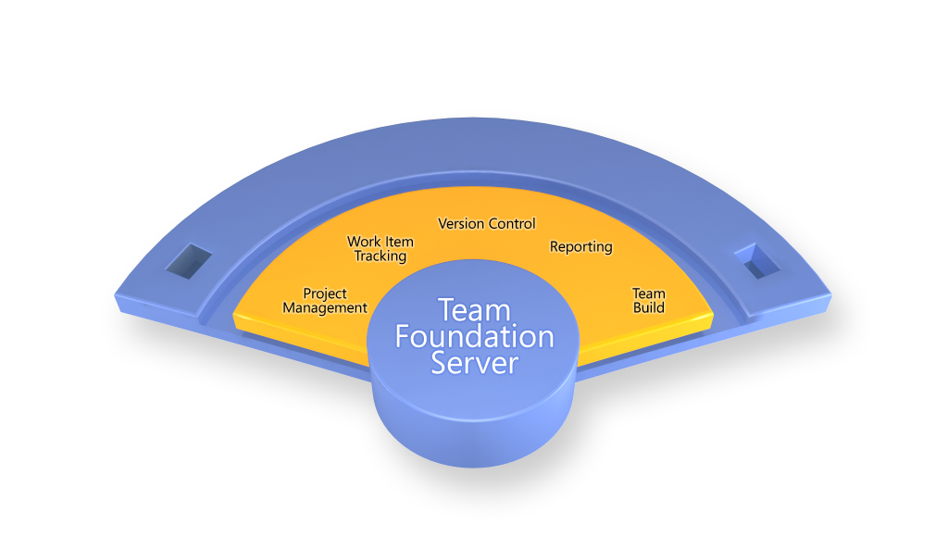
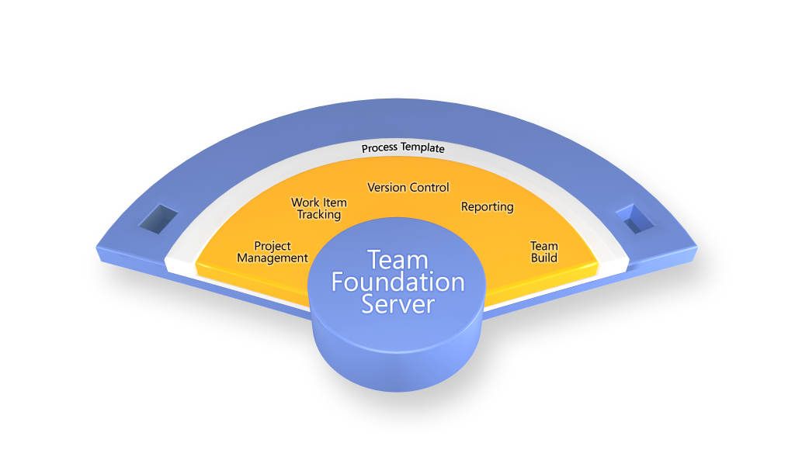
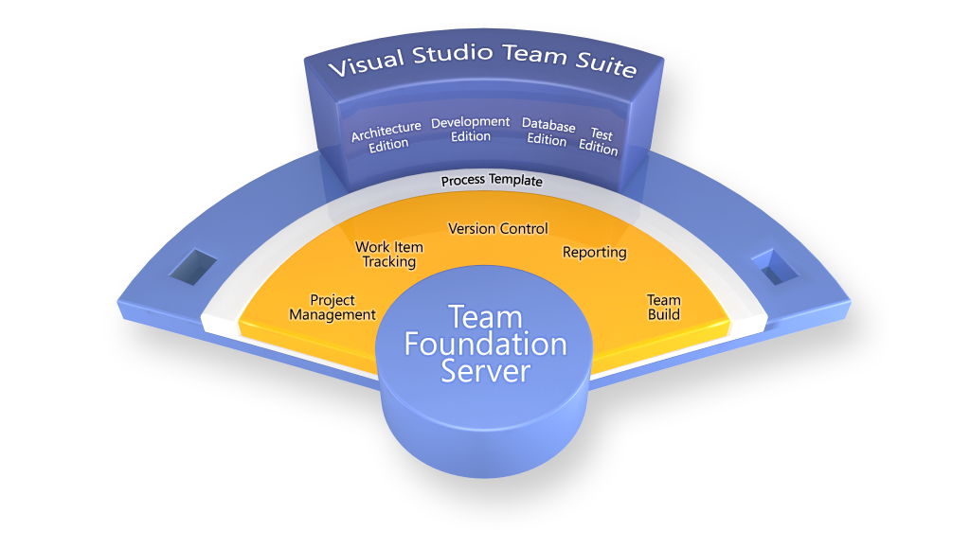
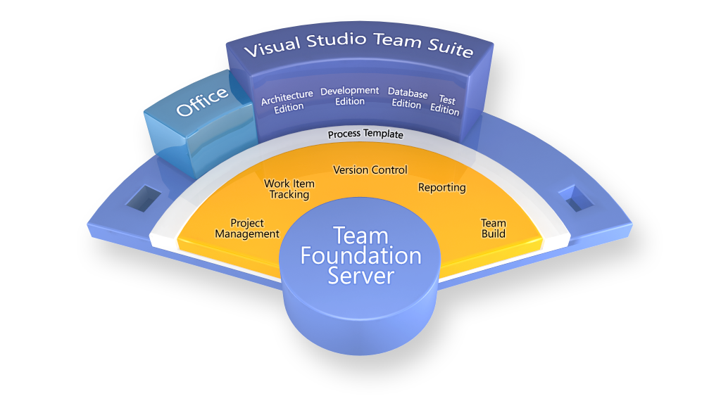
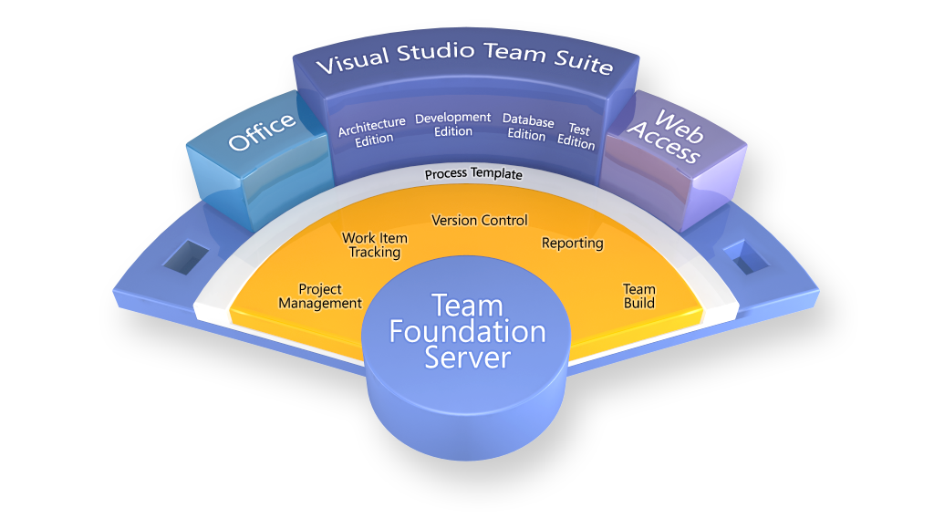
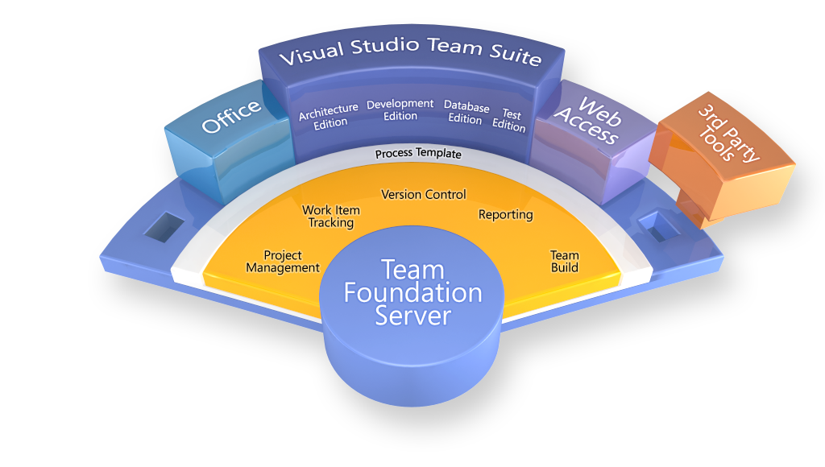
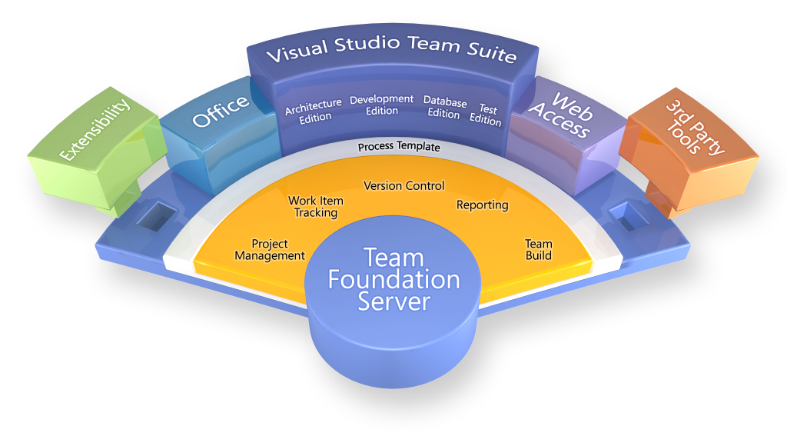
Visual Studio Team System Application Lifecycle Management (ALM) Solution
Notes:
Here’s an all-up view of what Team System is.

Slide 16
Visual Studio Team System
Visual Studio Team Suite
Software Architects
Software Developers
Software Testers
Database Professionals
Visual Studio Team Explorer
Visual Studio Industry Partners
Application Modeling
Code Analysis
Performance Testing
Database Deployment
Infrastructure and Deployment Modeling
Performance Tuning
Manual Testing
Database Change Mgmt.
Security Analysis
Test Case Management
Database Testing
Unit Testing
Code Coverage
MSF Process and Guidance
Class Modeling
(TFS Client Access License)
Visual Studio Professional Edition
Load Test Agent
Visual Studio Team Foundation Server
Change Management
Reporting
Integration Services
Work Item Tracking
Project Site
Project Management
Notes:
This is a cross-section of the previous.
Take a moment to mention the main capabilities in each area. Highlight that Team Suite encompasses all of this functionality in one package.

Slide 17
Today: Disparate Tools
Tool | Architect | Developer | Tester | PM | Stakeholder
Version Control | X | X | X | X
Defect Tracker | X | X | X | X | X
Task Tracker | X | X | X | X | X
IDE | X | X
Modeling Tool | X | X
Unit Tester |  | X | X
UI Tester |  | X | X
Load Tester |  |  | X
Test Manager |  |  | X
Web Portal |  |  |  |  | X
Reporting Tool | X | X | X | X | X

Slide 18
Team System: Role-based Capabilities
Tool | Architect | Developer | Tester | PM | Stakeholder
Team Architect | X
Team Developer |  | X
Team Tester |  |  | X
MS Project/Excel |  |  |  | X
Web Portal |  |  |  |  | X

Slide 19
Team System: The Ideal Solution
Tool | Architect | Developer | Tester | PM | Stakeholder
Team Suite | X | X | X | X
Web Portal |  |  |  |  | X

Slide 20
Collaborate & Communicate
Team Foundation Server
A unified project server
Developer
Database Professional
Designer
Architect
Tester
Business Analyst
Project Manager

Slide 21
Managing Team Workflow
Project Manager
Developer
Work Items
Architect
Tester
Database Developers
Users & BA’s
Notes:
Work item tracking throughout the lifecycle
Efficient management of tasks
Flexible and customizable
Enables traceability

Slide 22
Work Item Tracking
Manages any “item of record”
Extensible (fields, dialogs, workflow)
Accessible

Slide 23
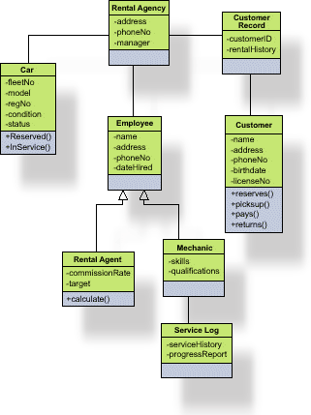
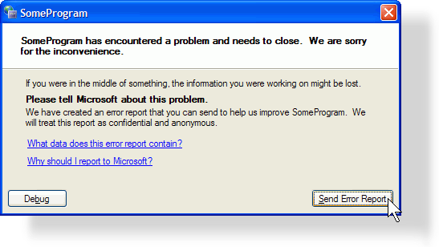
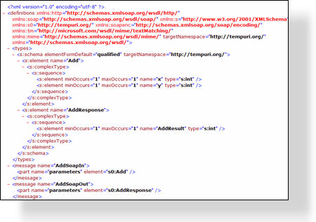
What is in a Work Item?
Proposed
Title
Description
Current State
Active
Active
Attachments
Scenario
Tasks
Bugs
Resolved
Who it is assigned to
Resolved
Links to other Work Items
Full Audited history
Closed
Closed
Anything else you want …

Slide 24
Drive Predictability
Integrated process templates help deliver predictable results

Slide 25
Process Template
Based on MSF
Agile
Several 3rd party templates
Scrum
Highly Flexible
Create your own or modify an existing one
XML based
Editor included
CMMI
RUP
Others

Slide 26
Ensure Quality, Early & Often
Quality Tools for All
Unit Testing
Database Testing
Functional testing
Code Analysis
Profiling
Load Testing

Slide 27
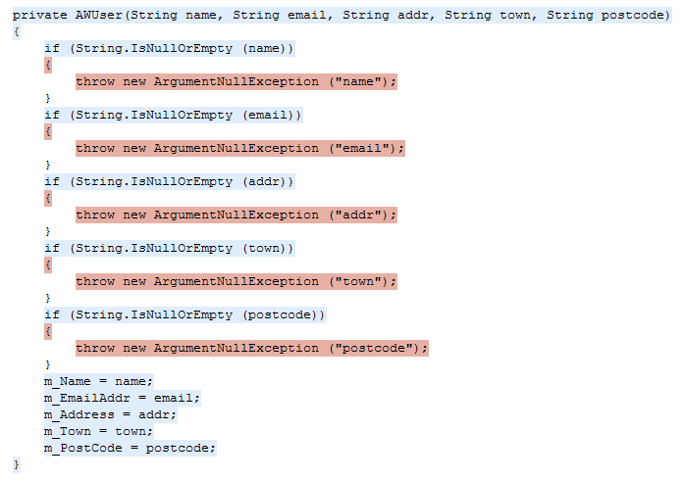
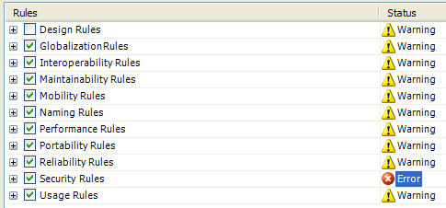
Ensure Quality, Early & Often Development
Integrated Unit Testing
Integrated Static Code analysis
Security Errors
Localisation problems
Memory issues
…
Integrated Profiler
Performance problems
Memory problems

Slide 28
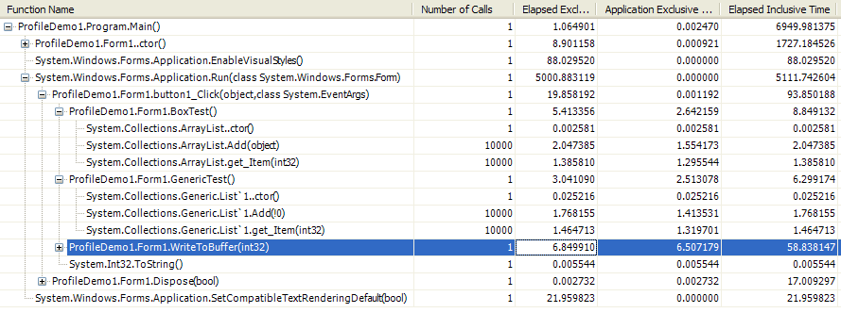
Ensure Quality, Early & Often Development

Slide 29
Ensure Quality, Early & Often Database Development
Take control of database change
Offline, change management of the schema
Refactoring of database objects
Automate database testing
Unit testing for Stored Procs
Automatic generation of meaningful test data
Bring data professionals into the lifecycle
Work Item tracking for database changes

Slide 30
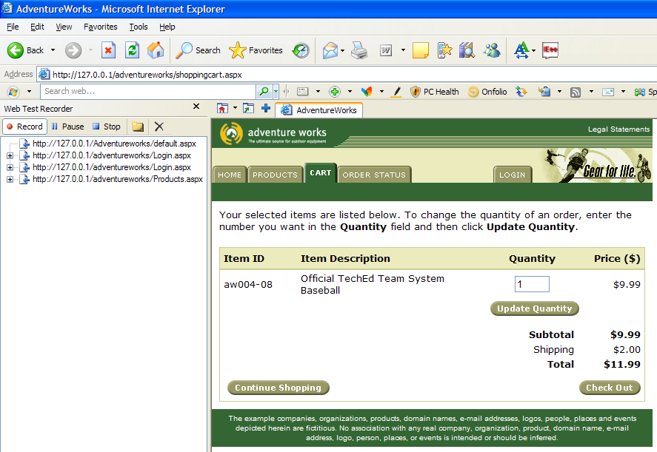
Ensure Quality, Early & Often Testing
Record Web Tests from Internet Explorer

Slide 31
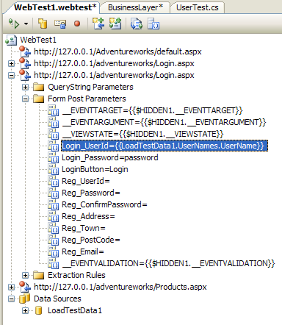
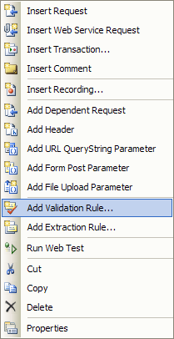
Ensure Quality, Early & Often Testing
Data driven tests
Validate returned data
Generate Code for the test (C#, VB, …)

Slide 32
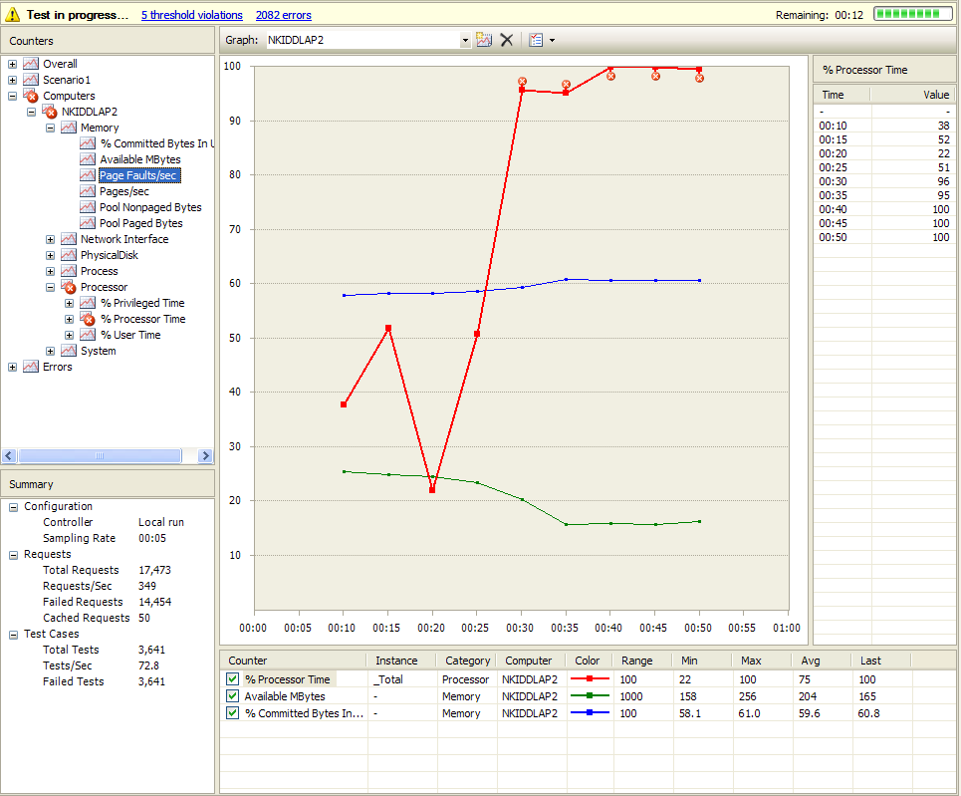
Ensure Quality, Early & Often Testing

Slide 33
Integrate Work Frequently
Full featured version control system
Continuous Integration
Scheduled Builds
Relate work item to check-in
Check-out on Edit
Labeling
Annotation
Shelving
Policy-based Check-in

Slide 34
Integrate Work Frequently Build Automation
Team Build
Extension of MS Build
Continuous Integration, scheduled, ad-hoc
Provides build reporting back to TFS
Integrates testing

Slide 35
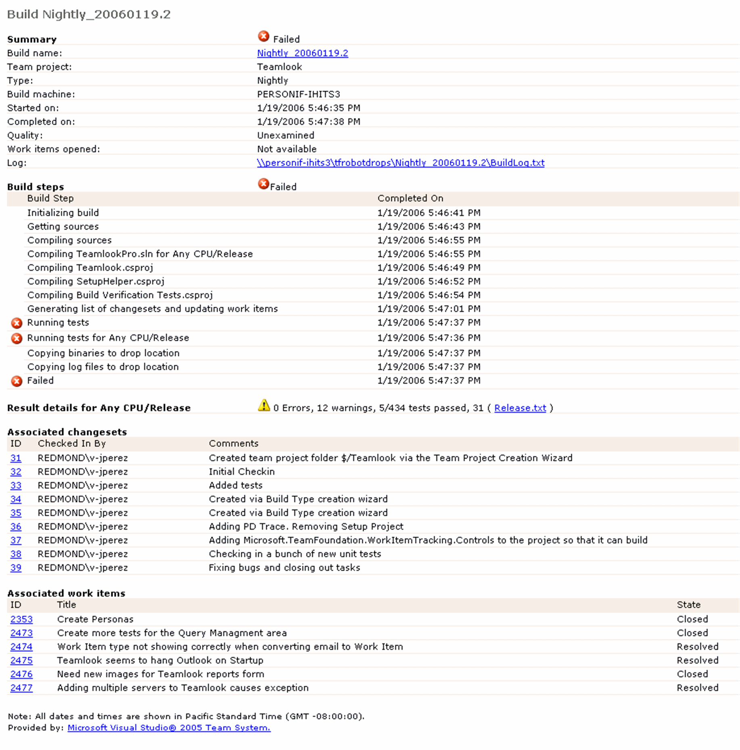
Integrate Work Frequently Build Reports

Slide 36
Team System 2010
And More is on the Way!

Slide 37
Visual Studio Team System 2010
Agile Project Planning
1-click Custom Excel reports
End to End Traceability
Database Edition merged
into Development
Stunning New Reports
TFS Administration
w/MMC
New Dashboards
Branch Visualization
Gated Checkin
Test Planning
Scalability ++
Build Windows
Workflow Integration
Distributed
Build
Test Execution
Manual Test Runner
Activity Diagram
Use Case Diagram
Test Impact
Analysis
Layer Diagram
Modeling Projects
Logical Class Diagram
Coded UI Test
Architecture
Explorer
Component Diagram
Sequence Diagram
Historical Debugging
Notes:
Summary slide showing new features to continue improving software development practices in VSTS 2010

Slide 38
Team System at Microsoft
Over 15,000 active users
Over 3.6 million work items
Over 3,100 Team Projects
56M+ source code files
Over 733,000 Builds
Notes:
Microsoft Developer Division runs on it:
3,501 unique users
515M files & 116M folders
3.9 TB when compressed!
30M downloads per week
650,393 Work Items
MSIT is complete on TFS
3,384 unique users
627,809 Work Items
SQL Server using WIT; Office & Windows using for feature tracking

Slide 39
Summary
Effective, Quality Toolset
Microsoft’s Application Lifecycle Solution
Promotes Collaboration
Integrates with Existing Tools

Slide 40
Notes:
40

